Slide 1

Industrial Training
Madhur Narang
06914803120
5-I4

Slide 2
Outline
Summer Training at Coding Ninjas.
Created a program for storing Contact List using C++
Main objective - Implement my knowledge of data structures in real life project.
An amazing experience as I got to see, how we use DSA professionally in real life application.

Slide 3
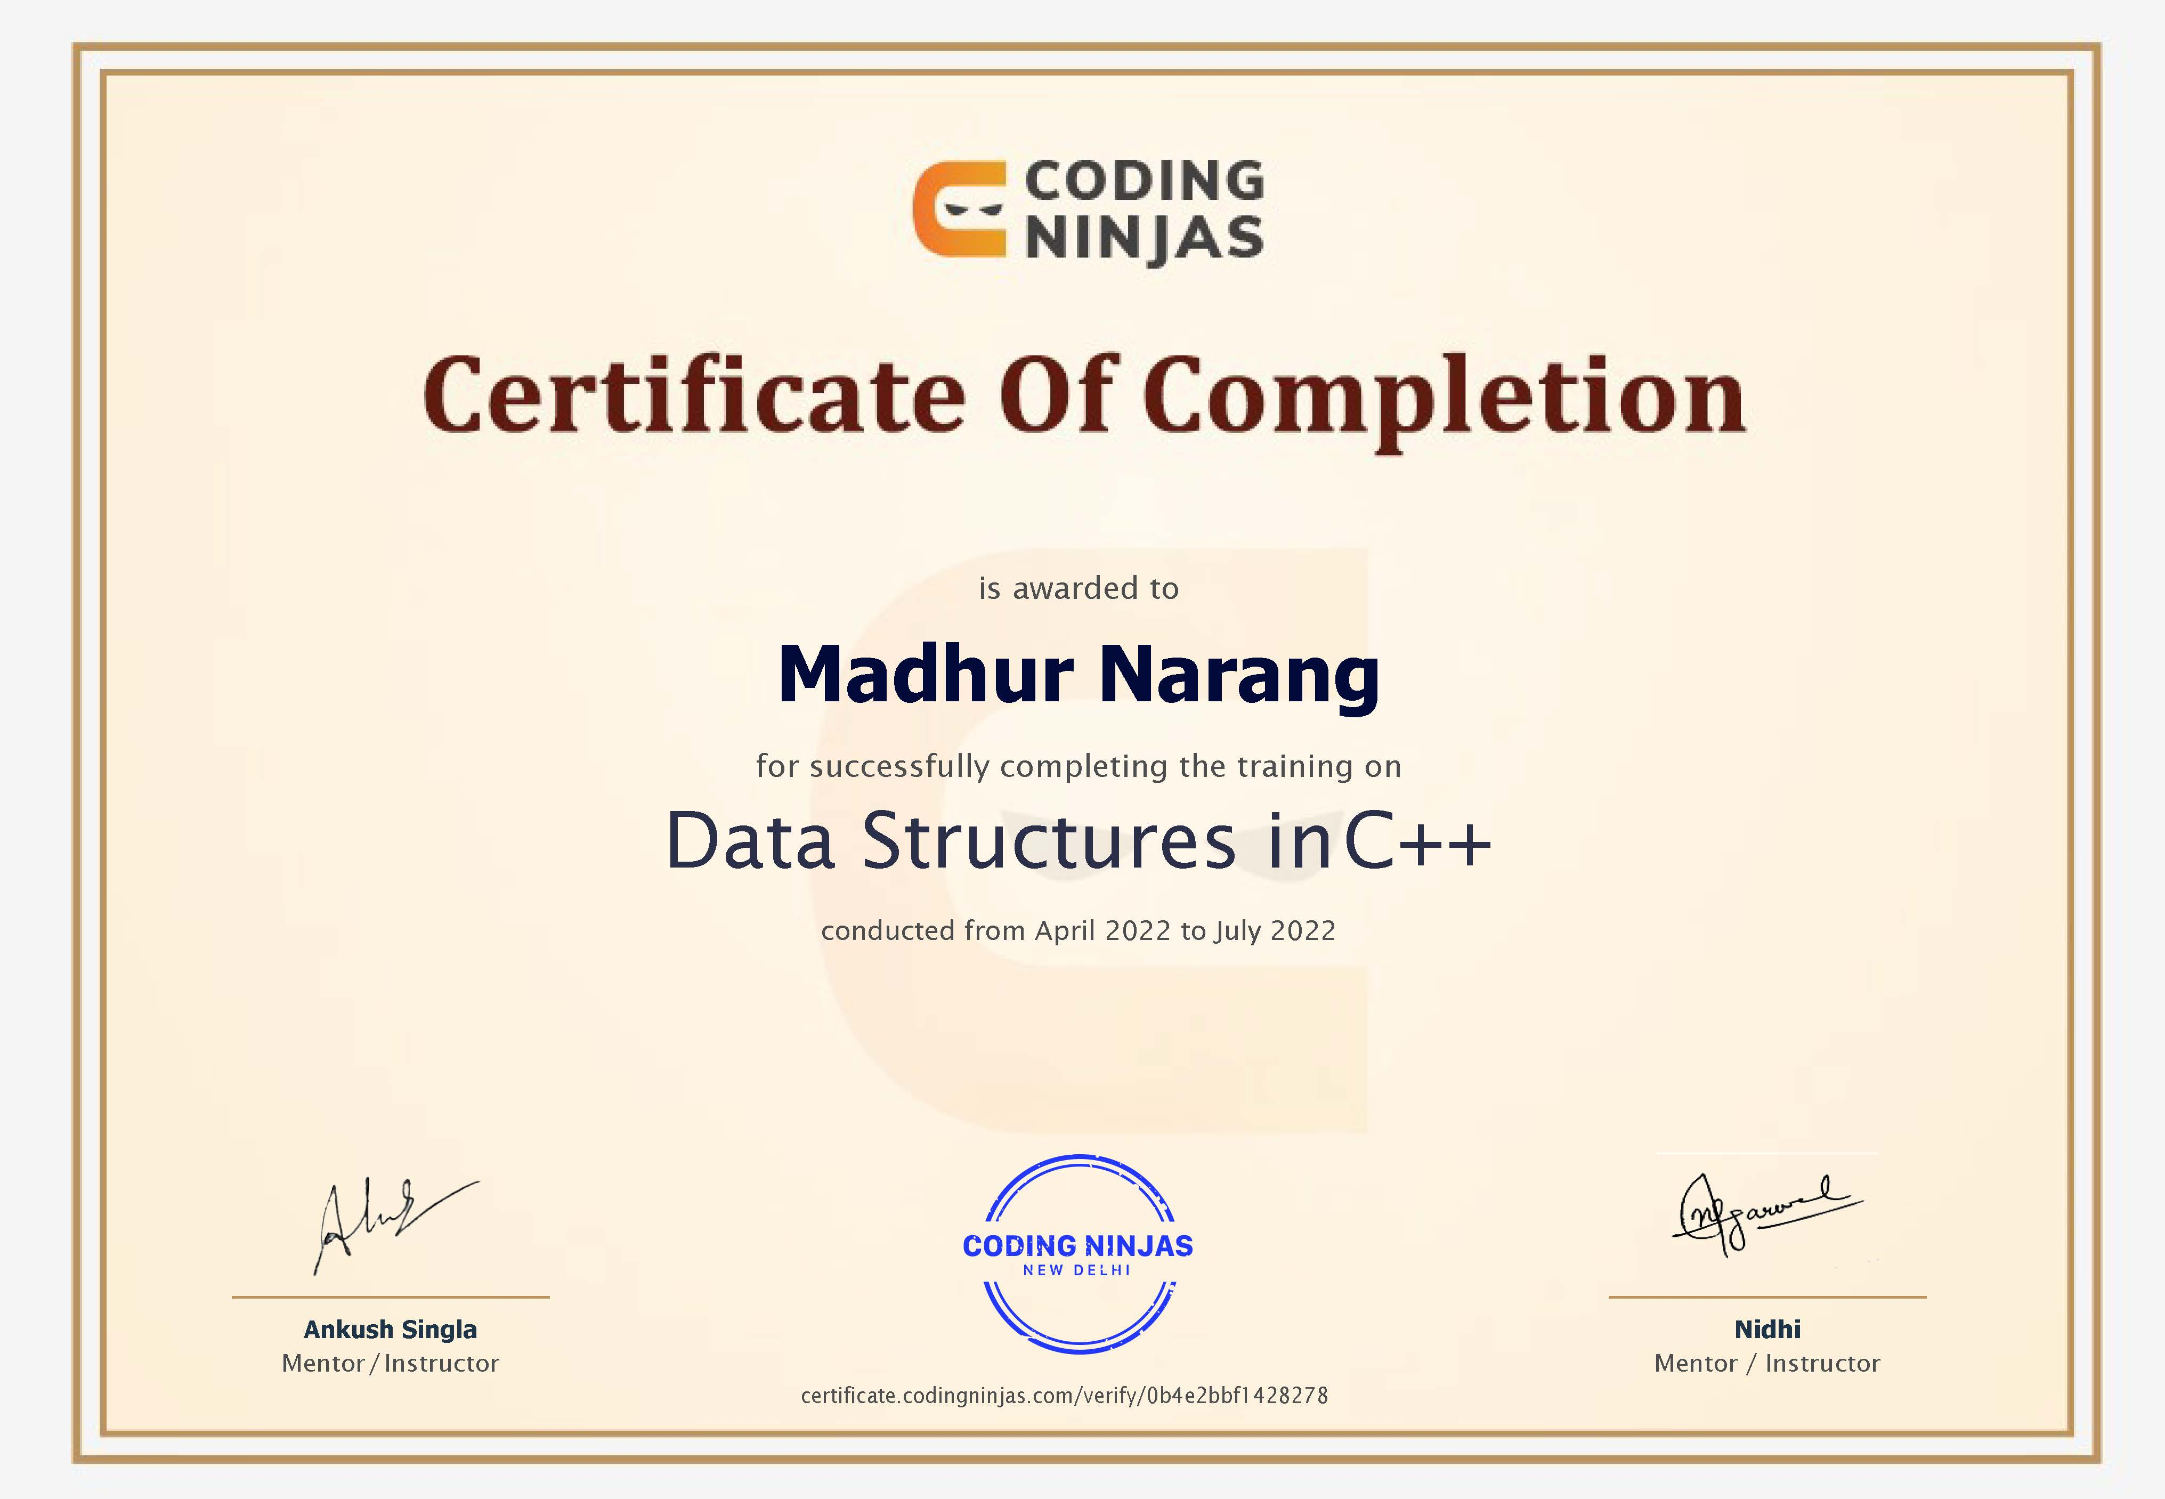
Certificate

Slide 4
Contents
Introduction to Coding Ninjas
01
Overview of Data Structures
02
Problem Definition
04
Limitation Of Existing report
05
Tools and Technology Used
06
Training Period
07
Program and Code Structure
08
Conclusion
09
Bibliography
10
About the course
03

Slide 5

Coding ninjas
Coding Ninjas boasts of world-class teaching faculty and a state-of-art learning platform for Coding education with faculty alumni of IIT, Stanford, IIIT and Facebook. Coding Ninjas teaches 17+ Programming courses in Foundational Advanced, Data & Development courses such as Machine Learning, Data Science, Web Development, Android and more. Today, Coding Ninjas ecosystem comprises of 40,000+ students and alumni, 1000+ Campus Ambassadors, 2000+ Teaching Assistants, and 150+ employees

Slide 6
Overview of DATA STRUCTURES
Data structures are the building blocks for more sophisticated applications. They are designed by composing data elements into a logical unit representing an abstract data type that has relevance to the algorithm or application.
It is not only important to use data structures, but it is also important to choose the proper data structure for each task. .
They provide a formal model that describes the way the data elements are organized.

Slide 7
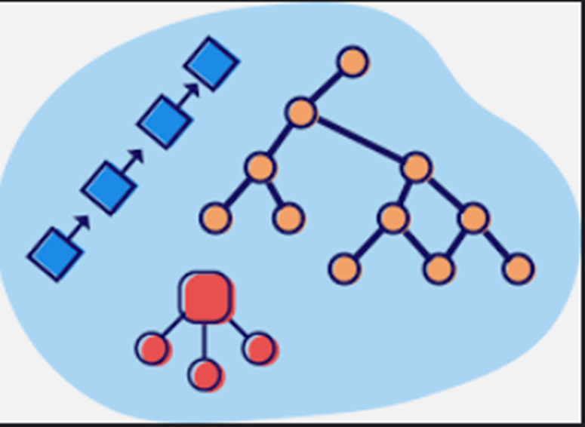
About the course
At Coding Ninjas, my Instructor Nidhi Agarwal helped me gain confidence to overcome the fear of data structures and their algorithms by helping me understand that being ignorant of such powers is a fool’s errand. Having understood that, I have now acquired the accursed knowledge of Data Structures such as:
A. Arrays
B. Linked Lists
C. Stacks & Queues
D. Hash Maps
E. Trees ,Tries & Heaps
F. Graphs

Slide 8

Problem Definition
The aim is to write a code using the concepts of Data Structure and Algorithms and Object-Oriented Programming to implement the program for making Contact-List. The code will be able to make easier for users to access and make new contacts very fast and easily. This program will save make people to access contacts in a from list very easily and convenience along with providing them a solution to have contact list if they are unable to access their mobile.

Slide 9

PROJECT POSTER

Slide 10

Limitations of exiting project
The current program does not cover all the aspects of contact saving since nowadays we can store a lot of information in contact of person like its address , birthday and nicknames too.
The next version of this program is capable to implement all the above features.

Slide 11

Tools and technology used
MINGW COMPILER
MinGW is a compiler system based on the GNU GCC and Binutils projects that compiles and links code to be run on Win32 (Windows) systems. It provides C, C++ and Fortran compilers plus other related tools. 'MinGW' refers to the "Minimalist GNU for Windows" project.

Slide 12

Tools and Technology used
DEV C++ IDE
The IDE uses a MinGW port of GCC (GNU Compiler Collection) as its compiler. MinGW is a minimalist approach to write executables for Windows systems. Dev C++ is also usable with Cygwin or any other GCC-based compiler. It was first built in Delphi and was upgraded using Delphi’s latest version.

Slide 13

Tools and technology used
CMD
Command Prompt, also known as cmd.exe or cmd, is the default command-line interpreter for the OS ArcaOS, Microsoft Windows (Windows NT family and Windows CE family), and ReactOS operating systems. On Windows CE. , It is referred to as the Command Processor Shell.

Slide 14
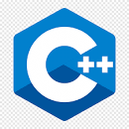
Tools and technology used
C++
C++ is a cross-platform language that can be used to create high-performance applications. C++ was developed by Bjarne Stroustrup, as an extension to the C language. C++ gives programmers a high level of control over system resources and memory. C++ is one of the world's most popular programming languages

Slide 15

Training period
During the training period, my main job was to learn about the course content which is Data Structure and Algorithm using C++ as the programming language and to practically implement these concepts. So, to implement it practically, I had to develop a project based on these things:
Setting up the things
Ordering the content
Designing phase
Folder Structuring

Slide 16
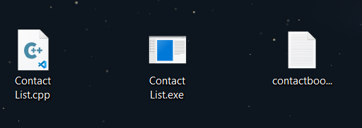

Project
The project is a Contact List program implemented using fundamental C++ and DSA. Project title is “CONTACT LIST". As the name suggests it helps you store and access your contact cards easily and even on computers.

Slide 17
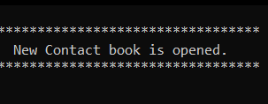
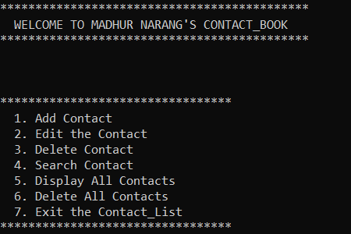
Program MAIN MenU
0. NEW CONTACT BOOK IS FORMED ON FIRST EXECUTION.
1. MAIN MENU OF THE PROGRAM IS DISPLAYED WITH ALL THE COMMANDS INCLUDING ADD , EDIT , DELETE & SEARCH.

Slide 18
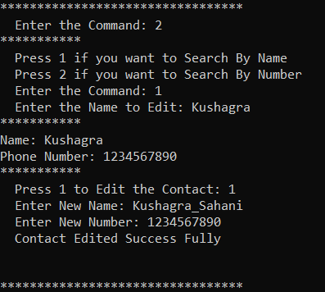
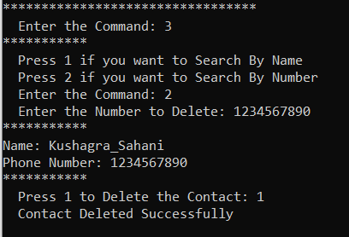
Different commands Execution
2. EDIT COMMAND SUCCESSFUL WHEN CONTACT IS THERE IN LIST.
3. DELETE COMMAND SUCCESSFUL WHEN CONTACT IS THERE IN LIST.

Slide 19
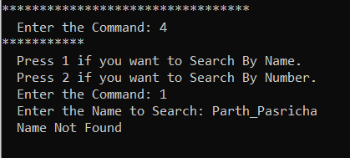
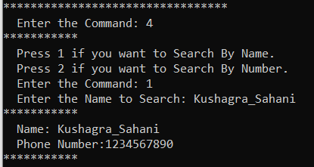
Different commands Execution
4.1. DELETE COMMAND RUNS FINE WHEN NO CONTACT IS THERE IN LIST WITH GIVEN NAME/NUMBER.
4.2. DELETE COMMAND SUCCESSFUL WHEN CONTACT IS THERE IN LIST WITH GIVEN NAME/NUMBER.

Slide 20
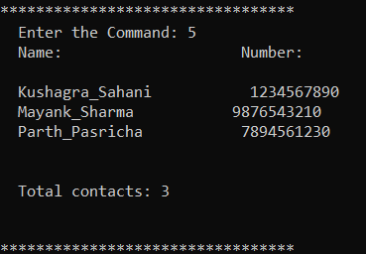

Different commands Execution
5. DISPLAY ALL COMMAND DISPLAYS ALL THE CONTACTS IN THE WHOLE LIST.
6. DELETE COMMAND SUCCESSFUL AND EMPTIES THE WHOLE CONTACT LIST.

Slide 21
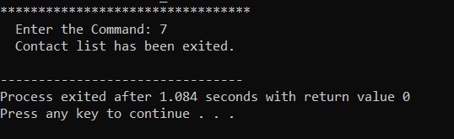
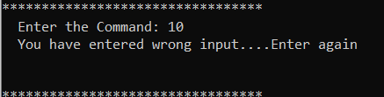
Different commands Execution
7. EXIT COMMAND STOPS THE PROGRAM EXECUTION AND ALL CHANGES ARE AUTOMATICALLY SAVED.
8. WHEN A WRONG COMMAND IS GIVEN THEN IT ENQUIRES FOR ANOTHER COMMAND.

Slide 22

Conclusion
Hence, after completing the training for Data Structure and Algorithm Course sufficient knowledge was gained to implement the concept of making own contact list program via various data structures and algorithms. The program was successfully made and achieved all the set objectives while also providing some real-life experience on how to solve real world problems using C++ programming language. Thus, the project was a success.

Slide 23
Bibliography
Javatpoint.com
Geeksforgeeks.com
Codingninjas.com
Tutorialspoint.com
Offline notes
Leetcode.com
Codechef.com

